Slide 1


| Career Excellence
What are Common Greetings ?

Slide 2
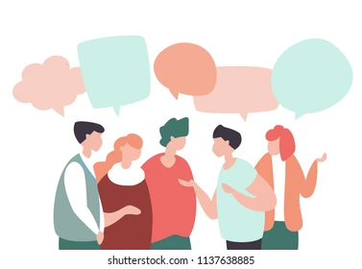
Common Greetings
“A simple hello can lead to a million things”

Slide 3
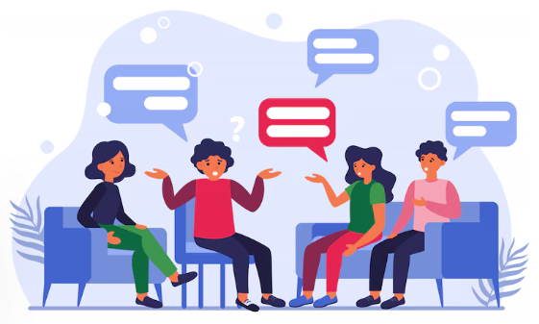
Session Agenda
What is a Greeting?
Verbal and Non-Verbal Forms of Greeting
Why Greetings Matter in Communication
Key Objectives of a Good Greeting
Respectful Communication Do's & Don’ts
Practice: Role-play & Feedback
Final Takeaways & Daily Use Tips
Notes:
CBC

Slide 4
What is a Greeting ?
A greeting is a way to acknowledge someone's presence
It starts most interactions and sets the tone
Greetings vary based on culture, context, and relationship
Notes:
CBC

Slide 5
Verbal and Non-Verbal Forms of Greeting
Verbal Greetings:
Hello
Good Morning / Good Afternoon
How are you?
Nice to meet you
Non-Verbal Greetings:
Smiling
Nodding
Handshakes
Bowing or gestures (cultural variations)
Notes:
CBC

Slide 6
Why Greetings Matter in Communication
Builds rapport and shows respect
Breaks the ice and creates connection
Essential in both personal and professional settings
Notes:
CBC

Slide 7
Key Objectives of a Good Greeting
Show politeness and cultural awareness
Set a friendly, open tone for the interaction
Make the other person feel acknowledged and valued
Notes:
CBC

Slide 8
Respectful Communication Do's & Don’ts
✅ Do: Smile, use names, adjust based on setting
❌ Don’t: Interrupt, use slang in formal situations, ignore cues
Be mindful of tone and body language to avoid miscommunication
Notes:
CBC

Slide 9
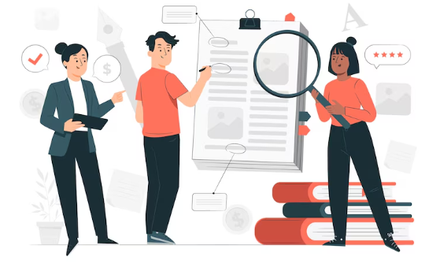
Practice: Role-play & Feedback
Practice greetings in pairs or small groups
Switch roles: formal, casual, professional settings
Give and receive constructive feedback on tone and delivery
Notes:
CBC

Slide 10
Final Takeaways & Daily Use Tips
Greetings are small but powerful tools.
They reflect your attitude and respect for others.
Both words and gestures matter.
Good communication starts with a good greeting.
Notes:
CBC

Slide 11
Thanks!

